Slide 1



PRACTICAL TOOLS FOR GROWING YOUR BUSINESS.

Slide 2
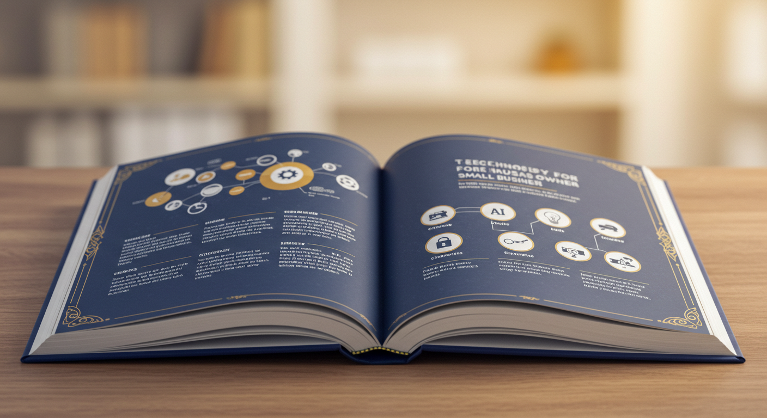
TABLE OF CONTENTS

Slide 3
CONTENTS
Why AI Matters
What does it mean? How does it work?
Spotify Case Study – Where AI went wrong…
Atlanta Falcon’s Stadium AI Case study – How AI made them the top 10 stadium in the Nation
Tooling: From Meeting notes to automating your sales. Your personal AI assistants
Content Creation – How to market with it.
Prompting.

Slide 4
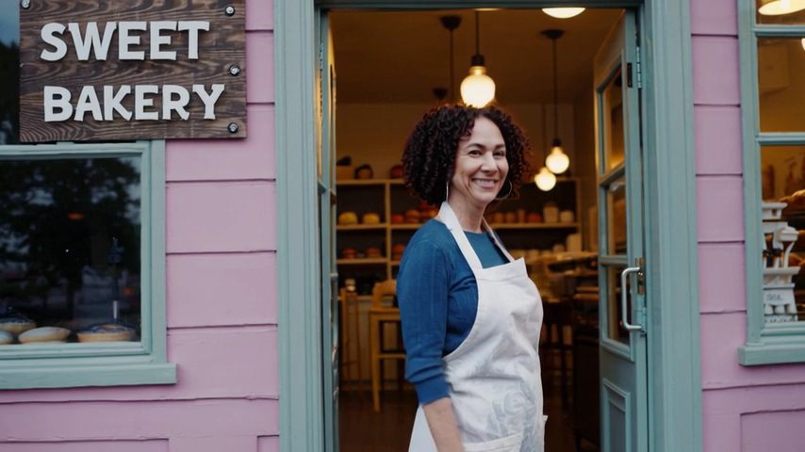
THE CHANGING LANDSCAPE.
Why Any of This Matters for You:
The world is changing fast, new tools are constantly born everyday- and tech is a big part of that.
AI will not only work “smarter” (via helping you out), but will also keep you competitive.
We don’t want you getting left behind- so let’s explore how AI can benefit your business today.

Slide 5

WHAT IS AI REALLY? –DON’T BE SCARED.

Slide 6
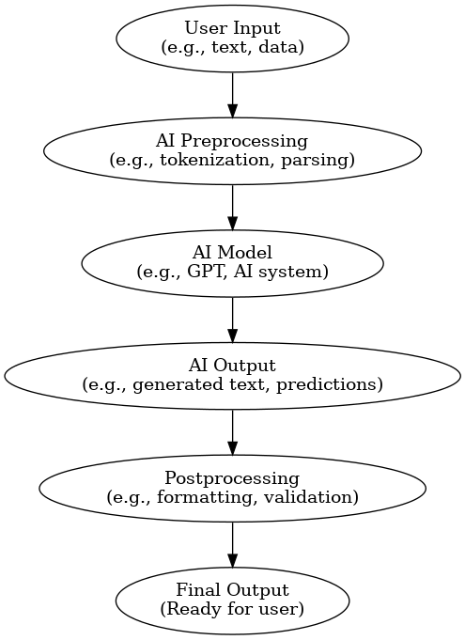
IT’S THIS FLOW.
It’s like an assembly line.

Slide 7
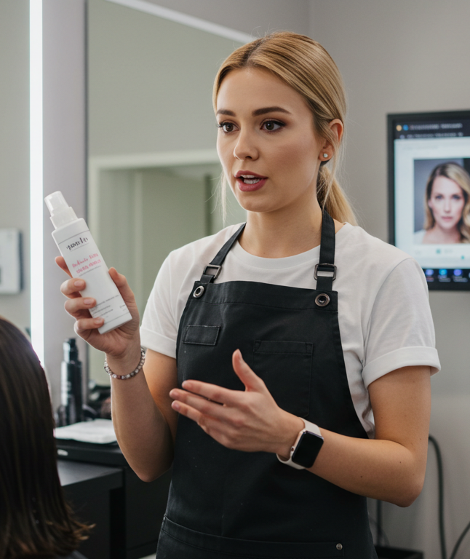
IT’S NOT ROCKET SCIENCE.
AI is just a computer that simply does what any task that would require human intelligence.
Think about it as as the tech savvy nephew, or niece that can help you set up wifi, configure a new machine in your warehouse etc.,
But what can it already do?
Predict Customer Preferences
Automate Repetitive/Custom Tasks
Analyze Sales Data for Anyone

Slide 8

EXAMPLE OF WHAT NOT TO DO: SPOTIFY’S MISSTEP
They tried to subsidize true creativity: Users were used to creative, unique experiences for what they listened to and observations based on a giant amount of user spread.
What they got? I mixed set of happiness based on this. No one was outspokenly saying they loved it, unlike previous years. The social media was backlash.
Generic, the death of creativity: these less engaging experiences were foreshadowed by a massive amount of layoffs, indicating the “buzz” in the worst way possible.

Slide 9
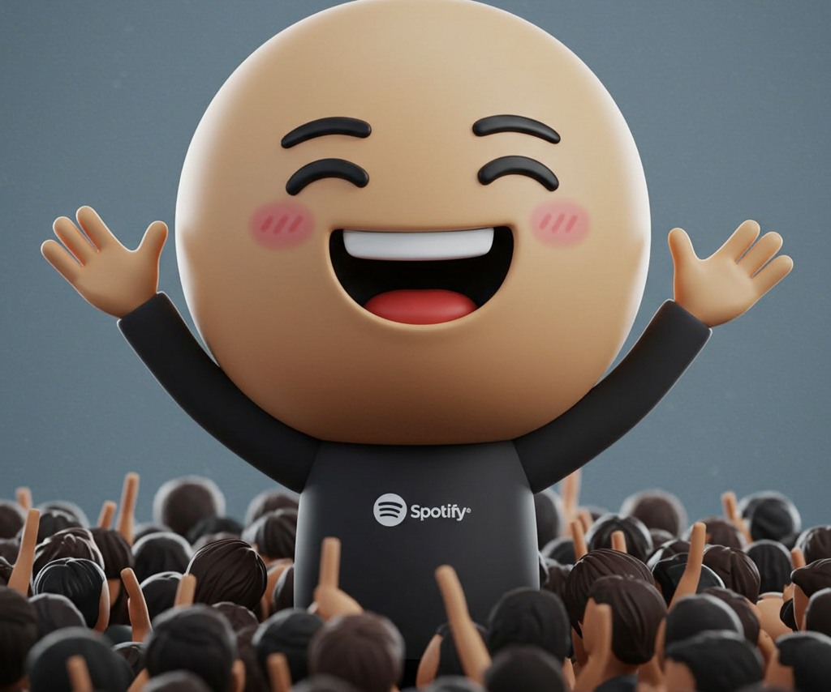
HOWEVER…
Spotify still did not get hurt, why? Cause it was all marketing to begin with. Spotify is a habitual habit for most and there are very few players in that industry.
Although their Q4 earnings have yet to come out, their stock price… has stayed the same, so using AI in these areas in the marketing/low cost areas could be your room to test and innovate. .

Slide 10
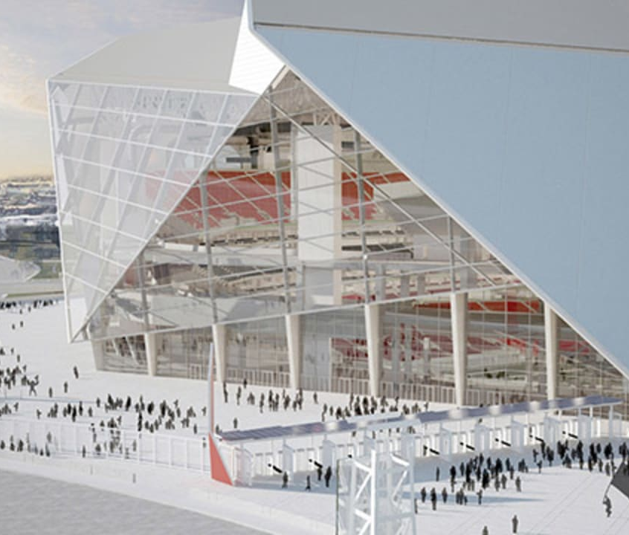
WHAT AI DID RIGHT.
How the Falcon’s stadium went from the worst to rated as one of the best customer experience stadium in the league with AI

Slide 11
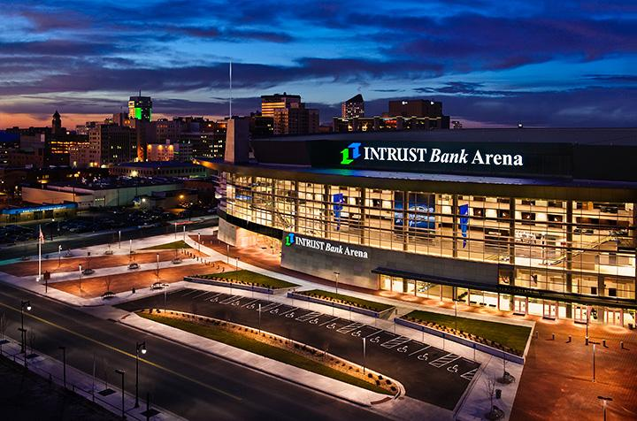
HOW MANY HERE HAVE GONE TO A STADIUM THAT WAS BAD?
The stadium doesn’t have enough PARKING!
Were the lines too long?
Was there certain parts of the stadium that were inaccessible from where you were?
Was the food mediocre?
Was the drinks too expensive?
Let’s take our own stadium :

Slide 12
THE FALCON’S STADIUM WIN. THE GEORGIA STADIUM LOST.
The shareholders and customers were extremely dissatisfied.
Many reported that the old layout, the Georgia DOME was not fit for modern day tech- which it wasn’t.
So they tore it down for hopes of:
To quote the owner, Rich McKay: “The LED displays we have, whether it's every seat is two-inches wider than the Georgia Dome, almost all the concourses connect so you can circumnavigate the building, you don't get cut-off. You can move vertically throughout the building, we have really wide staircases, we have twice the elevators, twice the escalators compared to the Georgia Dome.”

Slide 13
THE REDEFINED ERA
With Macquarium, IBM and Mercedes Benz behind them, they created AI systems that interact with fans from entrance gates, bathroom times, and food vendor lines.
With ETA’s on all facilities from parking to pickup, customer’s are enjoying the care-free environment so they can focus on what matter’s most- the game.
How can you use this?
Tools like Google Gemini, Perplexity, and ChatGPT can help redefine your products in ensuring that they’re the best for the market through:
Customer experience
Product Quality
User Interface (website or store)
Or redefine who your customers are! Here is how.

Slide 14
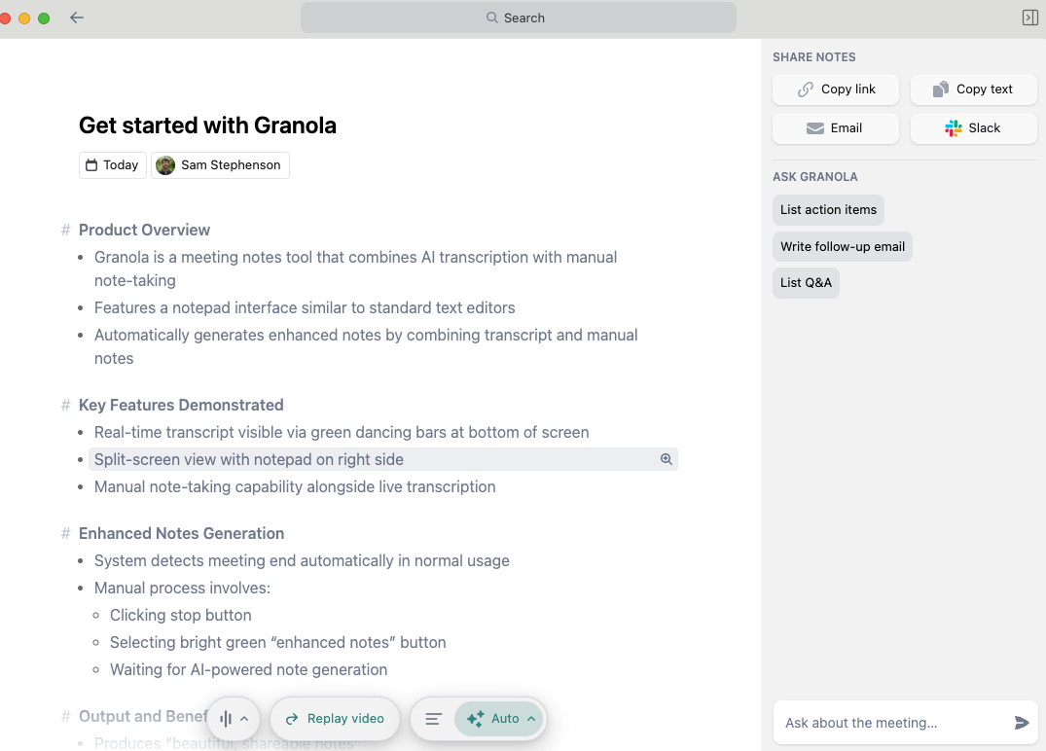
TOOLS – GRANOLA AI (SALES)
Your New AI assistant for Meetings
It records transcripts and is one of the most secure applications about meetings etc.,
You can use it to playback specific parts of the audio in case you missed some opportunities or insights
Generates notes for you on top of your typed notes.

Slide 15
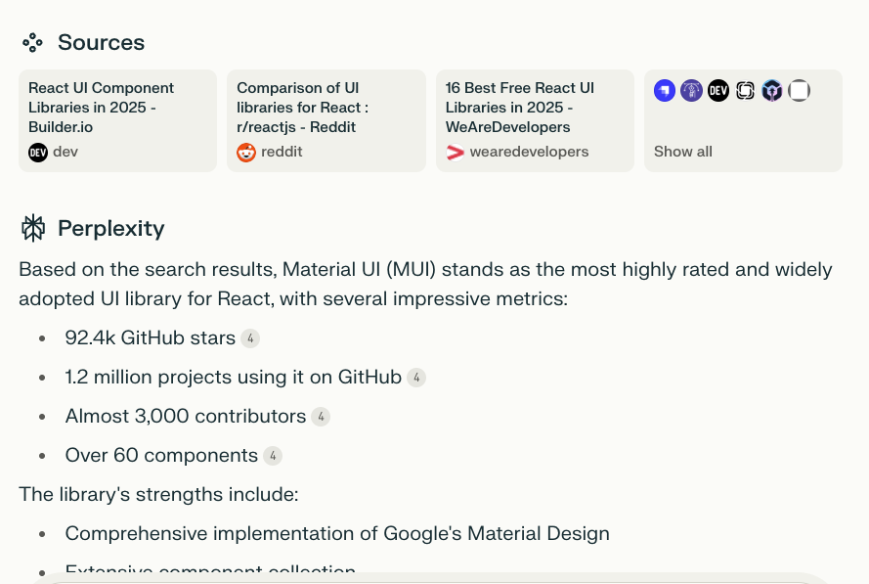
TOOLS – PERPLEXITY (MARKETING/RESEARCH)
Provides real time pain-point analysis, market research, and detailed queries.
Ask for competitor analysis, customer preferences, and TAM questions while providing you the resources to get you there.
Cons? A touch slow at getting the right queries.
Is up-to-date, but may use old data (web scraping issues)

Slide 16

TOOLS – GOOGLE GEMINI (MARKETING/RESEARCH/ PRODUCT ANALYSIS
BEST BANG FOR YOUR BUCK
Has unique GEMS to make specific requests to ie,. Personalities (Marketing, Product Experts, Coding, Customer Analysis)
Deep Research Tool. Will go and find all the things you need
Integration with Google Drive (and Workspace) if you use it.
Can access your Google Analytics, your drive, and even photos for you to create product pages.

Slide 17
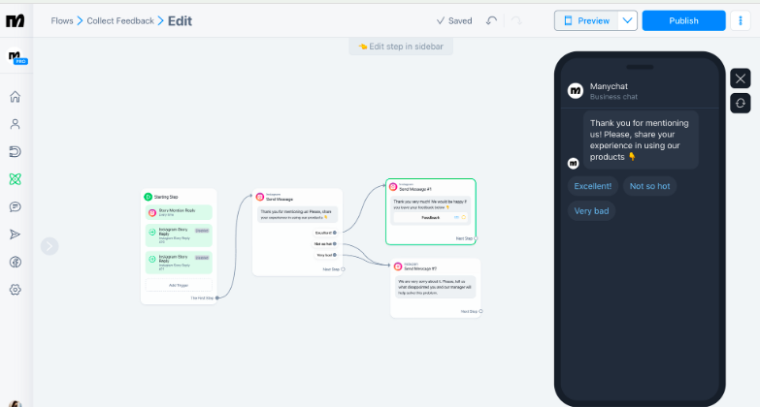
TOOLS – MANYCHAT & TIDIO (CUSTOMER SERVICE AI)
Use chatbots on your websites or via texts to answer common questions
Have these chatbots provid 24/7 customer support
Analyze FAQ and analytics to see if it’s worth it for you. – A big indicator would be the ROI of it.

Slide 18
TOOLS – ZAPIER (HIGHLY REPETITIVE TASKS)
Will save you significant time, via data entry, email notifications and scheduling
Integrates with nearly everything, reducing manual errors and increasing the efficiency of it all
Enhances accessibility and collaboration across your team members.

Slide 20

TOOLS – FISHBOWL (INVENTORY MANAGEMENT)
Tracks your inventory at any stage
Prioritized warehouse system
Integrates with nearly all platforms (Apple, Amazon, Quickbooks, salesforce, Shopify and Xero

Slide 21
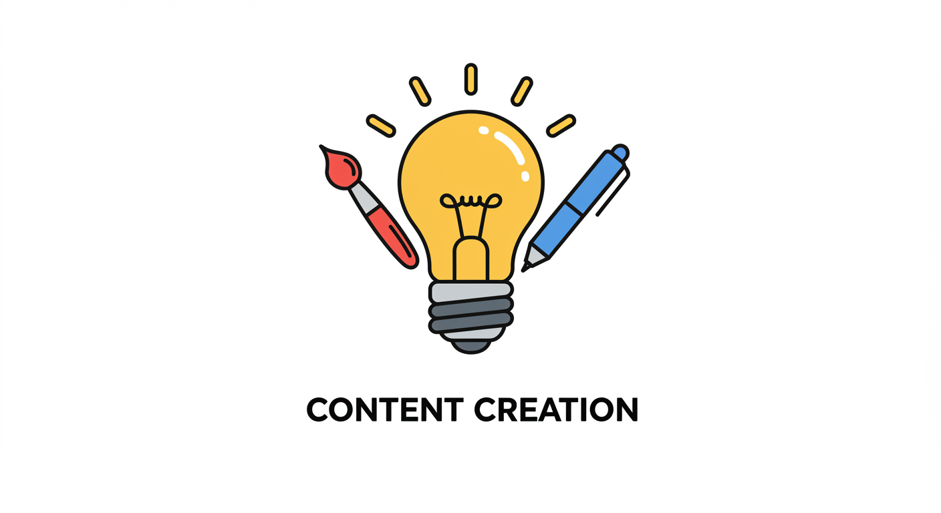
Content Creation
- Engaging content is crucial for attracting and retaining customers.
- AI tools can assist in generating high-quality content efficiently.
- Prompting techniques can enhance content quality and relevance.

Slide 22

Prompting
- Prompting enhances AI-generated content by providing clear guidance.
- It improves content relevance and alignment with objectives.
- Ensures content quality meets desired standards and expectations.

Slide 23
Prompting
- Prompting enhances AI-generated content by providing clear guidance.
- It improves content relevance and alignment with objectives.
- Ensures content quality meets desired standards and expectations.

Slide 24
Prompting
- Prompting enhances AI-generated content by providing clear guidance.
- It improves content relevance and alignment with objectives.
- Ensures content quality meets desired standards and expectations.

Slide 25
CONTENT CREATION
So we’ve talked a little bit about AI’s that can help with marketing, but in the age of AI- what truly matters?
Community, social direction, and networks.
Can you use AI to foster these? Absolutely, but first we must talk about…

